Slide 1
A Practical and Efficient Approach for Correct Z-Pass Stencil Shadow Volumes
Baran Usta
Leonardo Scandolo
Markus Billeter
Ricardo Marroquim
Elmar Eisemann
Delft University of Technology

Slide 2
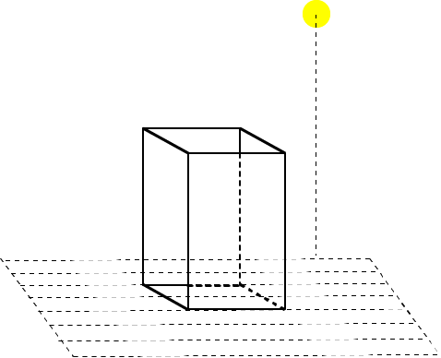
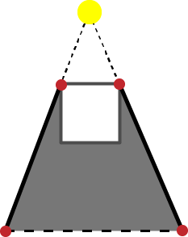
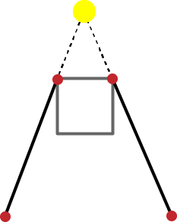
Shadow Volumes
Detect Silhouette Edges
Extend to the infinity
Generating quads
Volume in between the quads

Slide 3
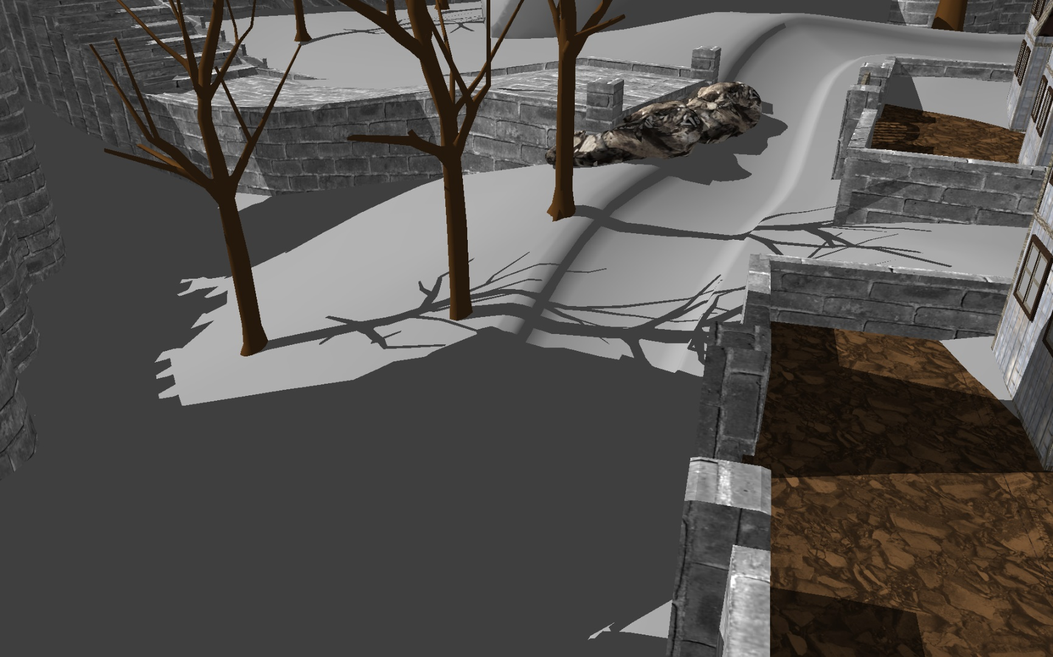
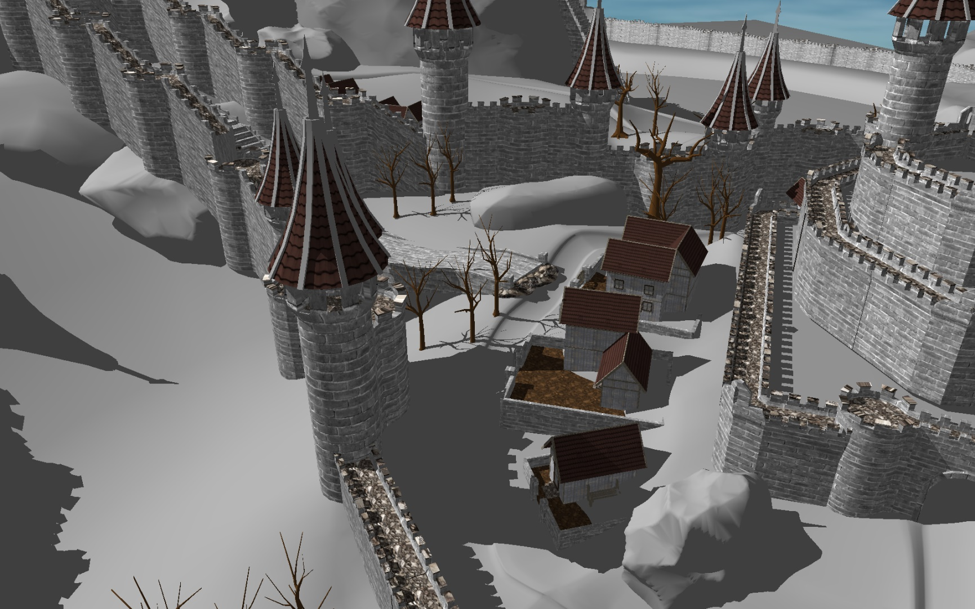
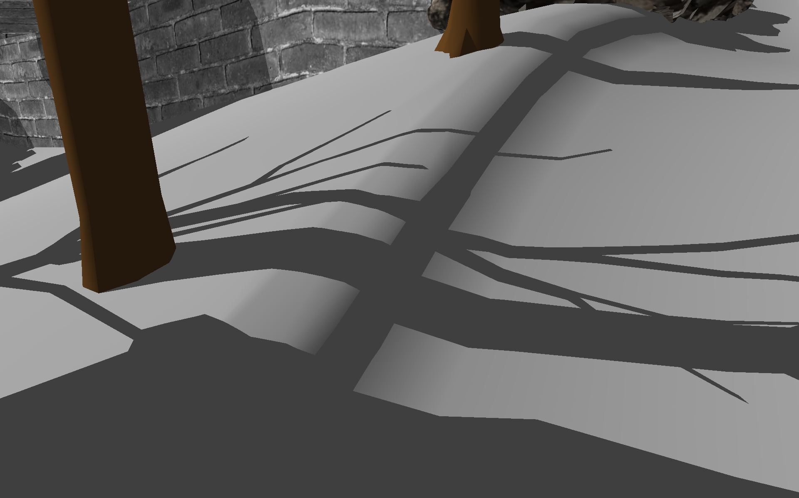
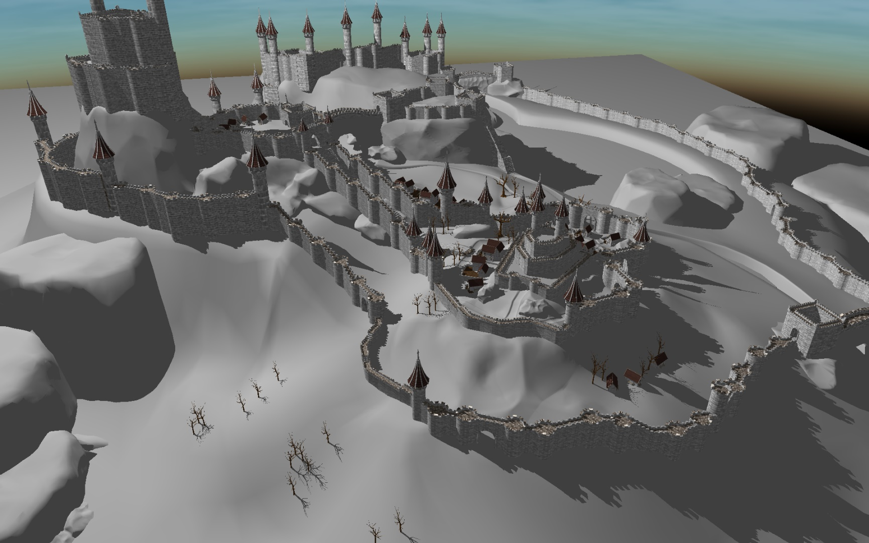
Shadow Volumes

Slide 4
Hard Shadow Rendering
Ray Tracing
[Appel 1968]
Irregular Z-Buffer
[Johnson et al. 2005]
Shadow Volumes
[Crow 1977]
Real time support is not widespread on current commodity hardware
Inconsistent performance

Slide 5
Shadow Volumes [Crow 1977]
Render Scene to fill depth buffer
Construct the shadow quads
Count the front and back facing quads in each pixel between camera and visible point
Front facing > back facing = in shadow
Otherwise = lit
Counting order does not matter
GPU

Slide 6
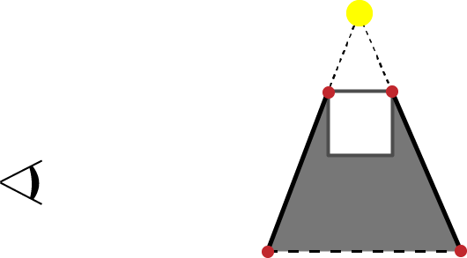
Shadow Volumes [Crow 1977]
FF
BF
1
1
0
0

Slide 7
Shadow Volumes [Crow 1977]
FF
BF
1
0
0

Slide 8
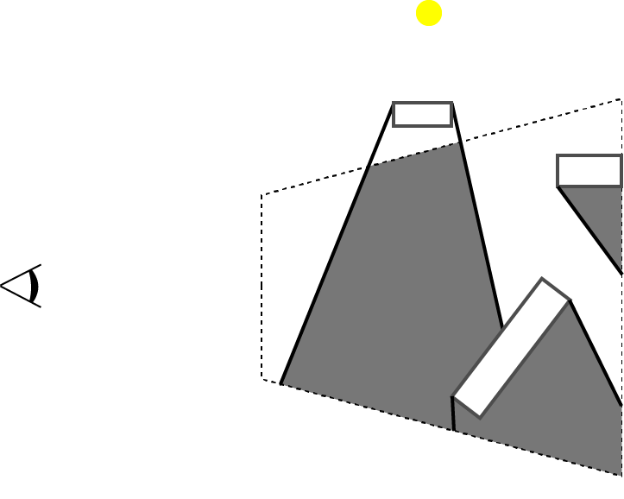
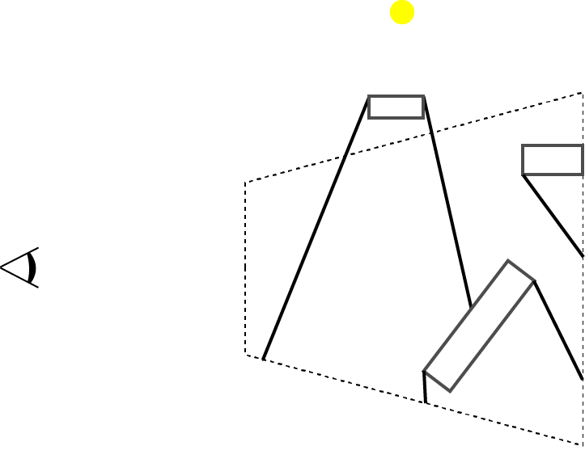
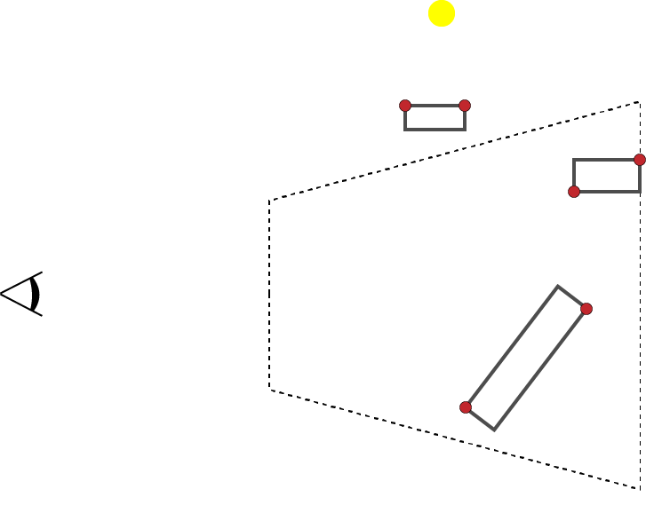
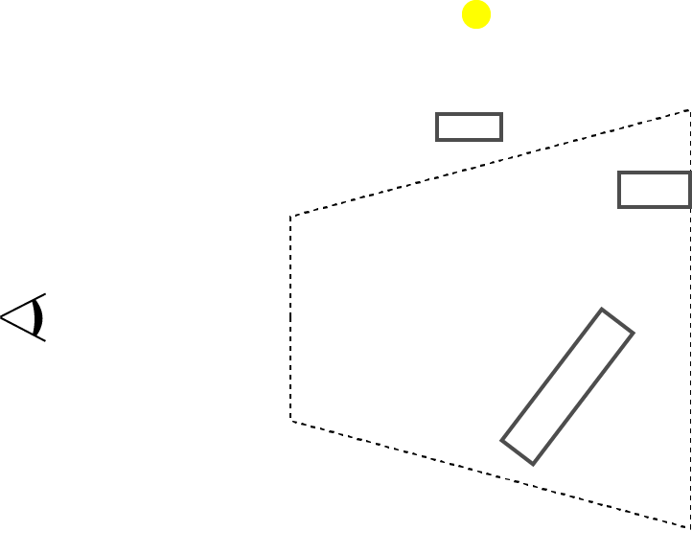
Z-Pass [Heidmann 1991]
Render Pass(Fill Depth Buffer)
Render Pass (Stencil)
Detect silhouette edges
Generate shadow volumes
Update stencil values with enabled depth test
0
0
0
0
0
0
0
0
0
0

Slide 9
Z-Pass [Heidmann 1991]
Render Pass(Fill Depth Buffer)
Render Pass (Stencil)
Detect silhouette edges
Generate shadow volumes
Update stencil values with enabled depth test
Render Pass (Shading)
Pixels with stencil value 0 are lit
0
+1
0
+1
+1
+1
0
+1
0
0
0
0
+1
0
+1
+1
0
0
0
0
0
-1
+1

Slide 10
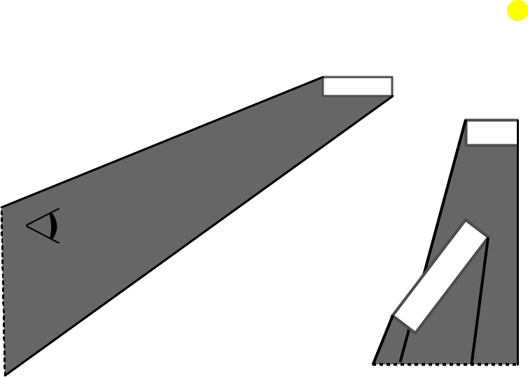
Z-Pass Limitation
FF
BF
Remark
What if the light source is in shadow?
1
1
0
0

Slide 11
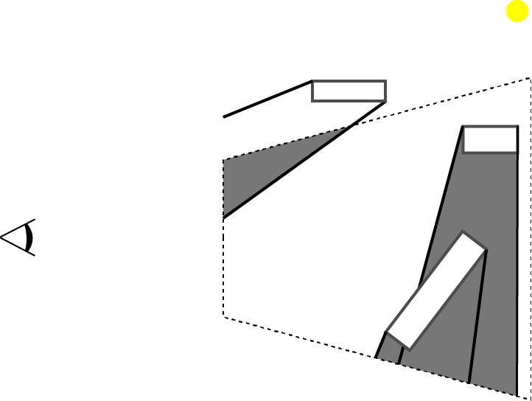
Z-Pass Limitation
Remark
What if the light source is in shadow?
Fail case for Z-Pass
0
0
+1
0
0
+1
0
0
+1
0
0
0
0
0
0
0
-1
+1

Slide 12
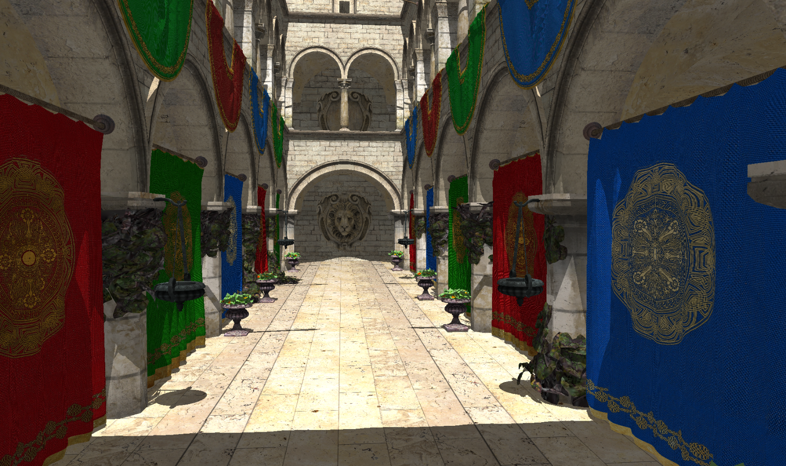
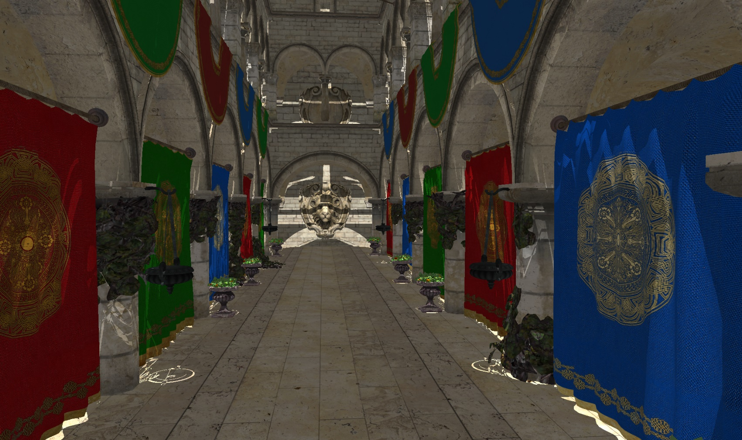
Z-Pass

Slide 13
Stencil Shadow Volumes
Render Pass(Fill Depth Buffer)
Render Pass (Stencil)
Detect silhouette edges
Generate shadow volumes
Update stencil values
Render Pass (Shading)
Pixels with stencil value 0 are lit

Slide 14
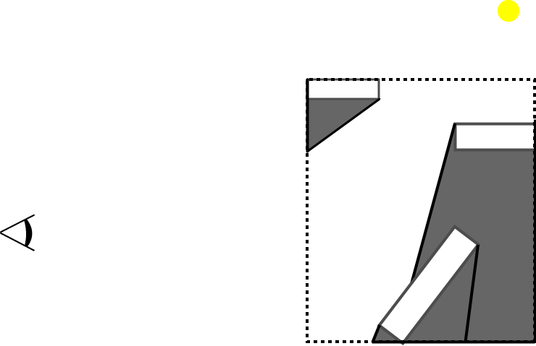
Z-Fail [Carmack 2000, Everitt & Kligard 2002]
Cut shadow volumes against scene Bbox
Create Caps
We can count intersections to any point outside the Bbox
+1
+1
-1

Slide 15
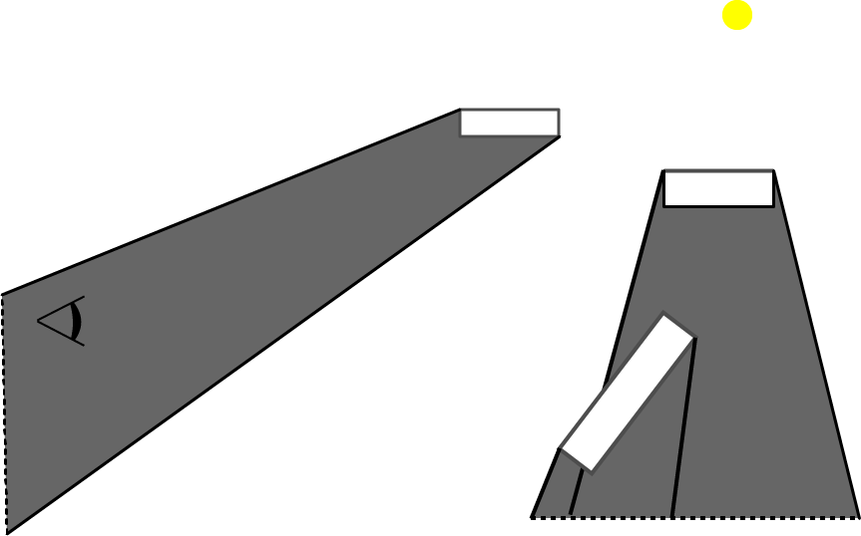
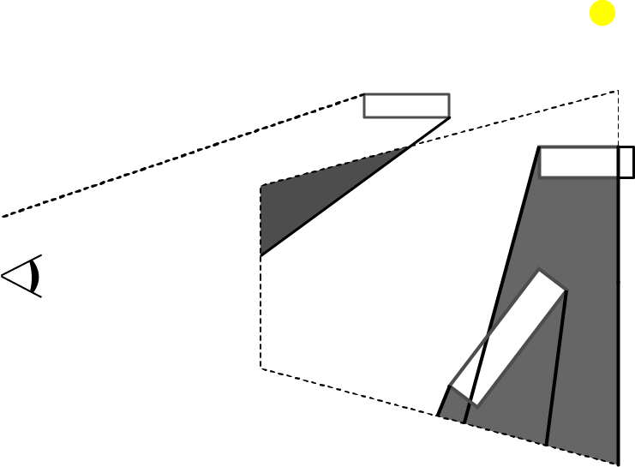
Z-Fail
Depth Clamping

Slide 16
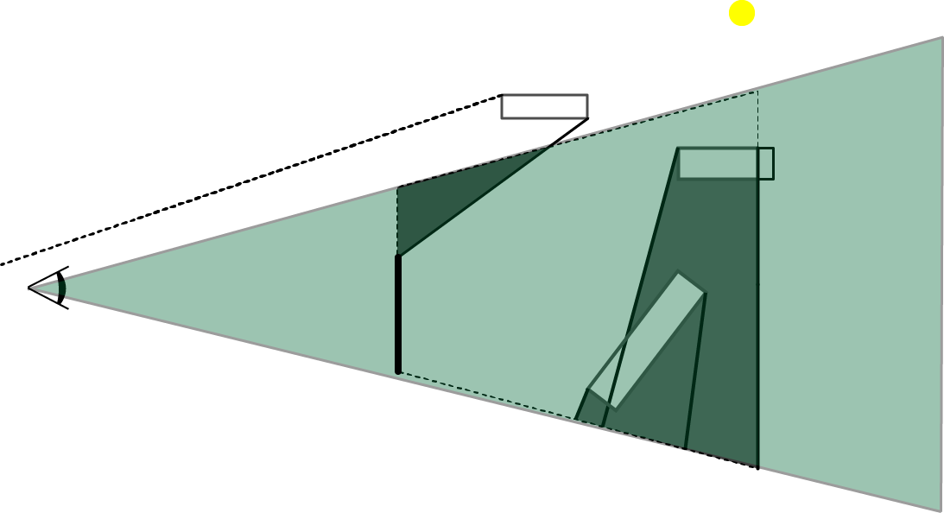
Z-Fail
Can we count from any point?

Slide 17
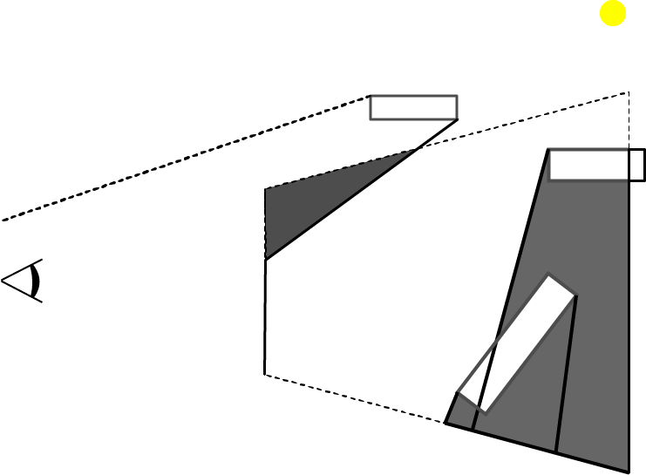
Z-Fail
Pick a point behind the far plane
Count the shadow quads between visible point and the picked point.
In practice: enabling inverse depth test
+1

Slide 18
Z-Fail
Render Pass(Fill Depth Buffer)
Render Pass (Stencil) with depth clamp
Detect silhouette edges
Generate shadow volume
Render Front & Back Cap
Update stencil values
Enabled inverse depth test
Render Pass (Shading)
Pixels with stencil value 0 are lit
+1
0
+1
+1
0
0
0
+1
+1
0
0
0
0
0
0
0
0
+1
0
0
0

Slide 19
Z-Fail Limitations
Render Pass(Fill Depth Buffer)
Render Pass (Stencil) with depth clamp
Detect silhouette edges
Generate shadow volume
Render Front & Back Cap
Update stencil values
Enabled inverse depth test
Render Pass (Shading)
Pixels with stencil value 0 are lit
Excessive overdraw

Slide 20
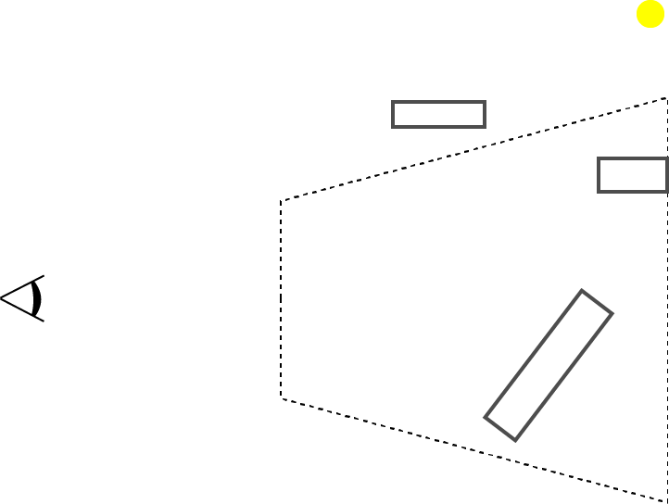
ZP+ [Hornus et al. 2005]
Z-Pass shadow calculation
Render Pass (from light source)
Light source to near plane
Update all the stencil values

Slide 21
ZP+ [Hornus et al. 2005]
Render Pass(Fill Depth Buffer)
Render Pass(*es) - (Stencil)
From light source to near plane
Update stencil values
From camera to scene
Detect silhouette edges
Generate shadow volumes
Update stencil values with enabled depth test
Render Pass (Shading)
Shade the pixels with 0 stencil
0
0
0
0
0
+1
+1
+1
0
0
0
0
+1
+1
0
0
+1
+1
0
0
0
0
+1
+1
0
0
-1

Slide 22
ZP+ Limitations
Render Pass(Fill Depth Buffer)
Render Pass(*es) - (Stencil)
From light source to near plane
Update stencil values
From camera to scene
Detect silhouette edges
Generate shadow volumes
Update stencil values with enabled depth test
Render Pass (Shading)
Shade the pixels with 0 stencil
Full screen size draw
Implementation Complexity

Slide 23
++ZP [Eisemann et al. 2011]
Standard Z-Pass
Render Pass
Light source to camera
1 pixel sized target
Depth Clamp

Slide 24
++ZP
Render Pass (Depth)
Render Pass(*es) - (Stencil)
From light source to camera
1 pixel render target
From camera to scene (Z-Pass w/ depth clamping)
Detect silhouette edges
Generate shadow volumes
Update stencil values with enabled depth test
3. Render Pass (Shading)
Shade the pixels with 0 stencil
+1
+1
+1
+1
+1
+1
+1
+1
+1
0
+1
0
+1
+1
0
0
+1
+1
+1
+1
+1
0
0
0
0
0
0
+1
+1
0
0
-1
1
0
-1

Slide 25
++ZP Limitations
Render Pass (Depth)
Render Pass(*es) - (Stencil)
From light source to camera
1 pixel render target
From camera to scene (Z-Pass w/ depth clamping)
Render Pass (Shading)
Shade the pixels with 0 stencil
Draw call for the whole scene
Our approach combines these two passes

Slide 26
Our Method

Slide 27
Atomic ZP
Render Pass (Depth)
Render Pass (Stencil) with depth clamp
Test triangle intersection with ray from light to camera and whether front facing
Increment the atomic counter
Detect silhouette edges
Generate shadow volumes
Update stencil values with enabled depth test
Render Pass (Shading)
If stencil value plus the atomic counter equals 0 the point is lit
0
0
0
0
0
-1
0
0
-1
-1
-1
0
0
-1
-1
1
0

Slide 28
Results
Render Pass (Fill Depth Buffer)
Render Pass(*es) - (Stencil)
From Light to * (ZP+ & ++ZP)
From camera to scene
Detect silhouette edges
Render shadow quads
Update stencil values
Render Pass (Shading)

Slide 29
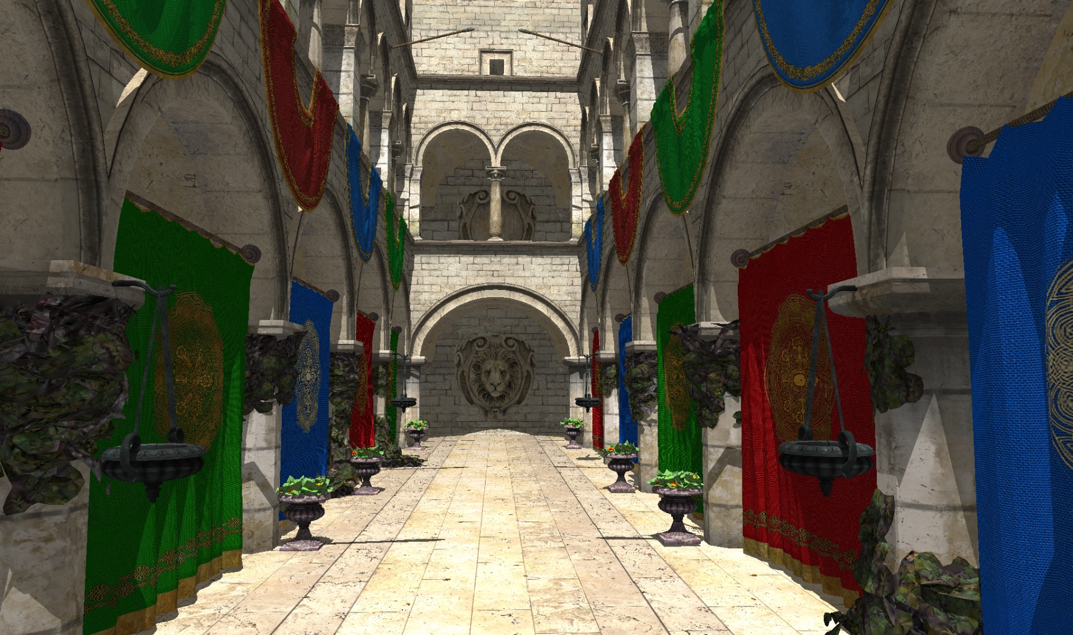
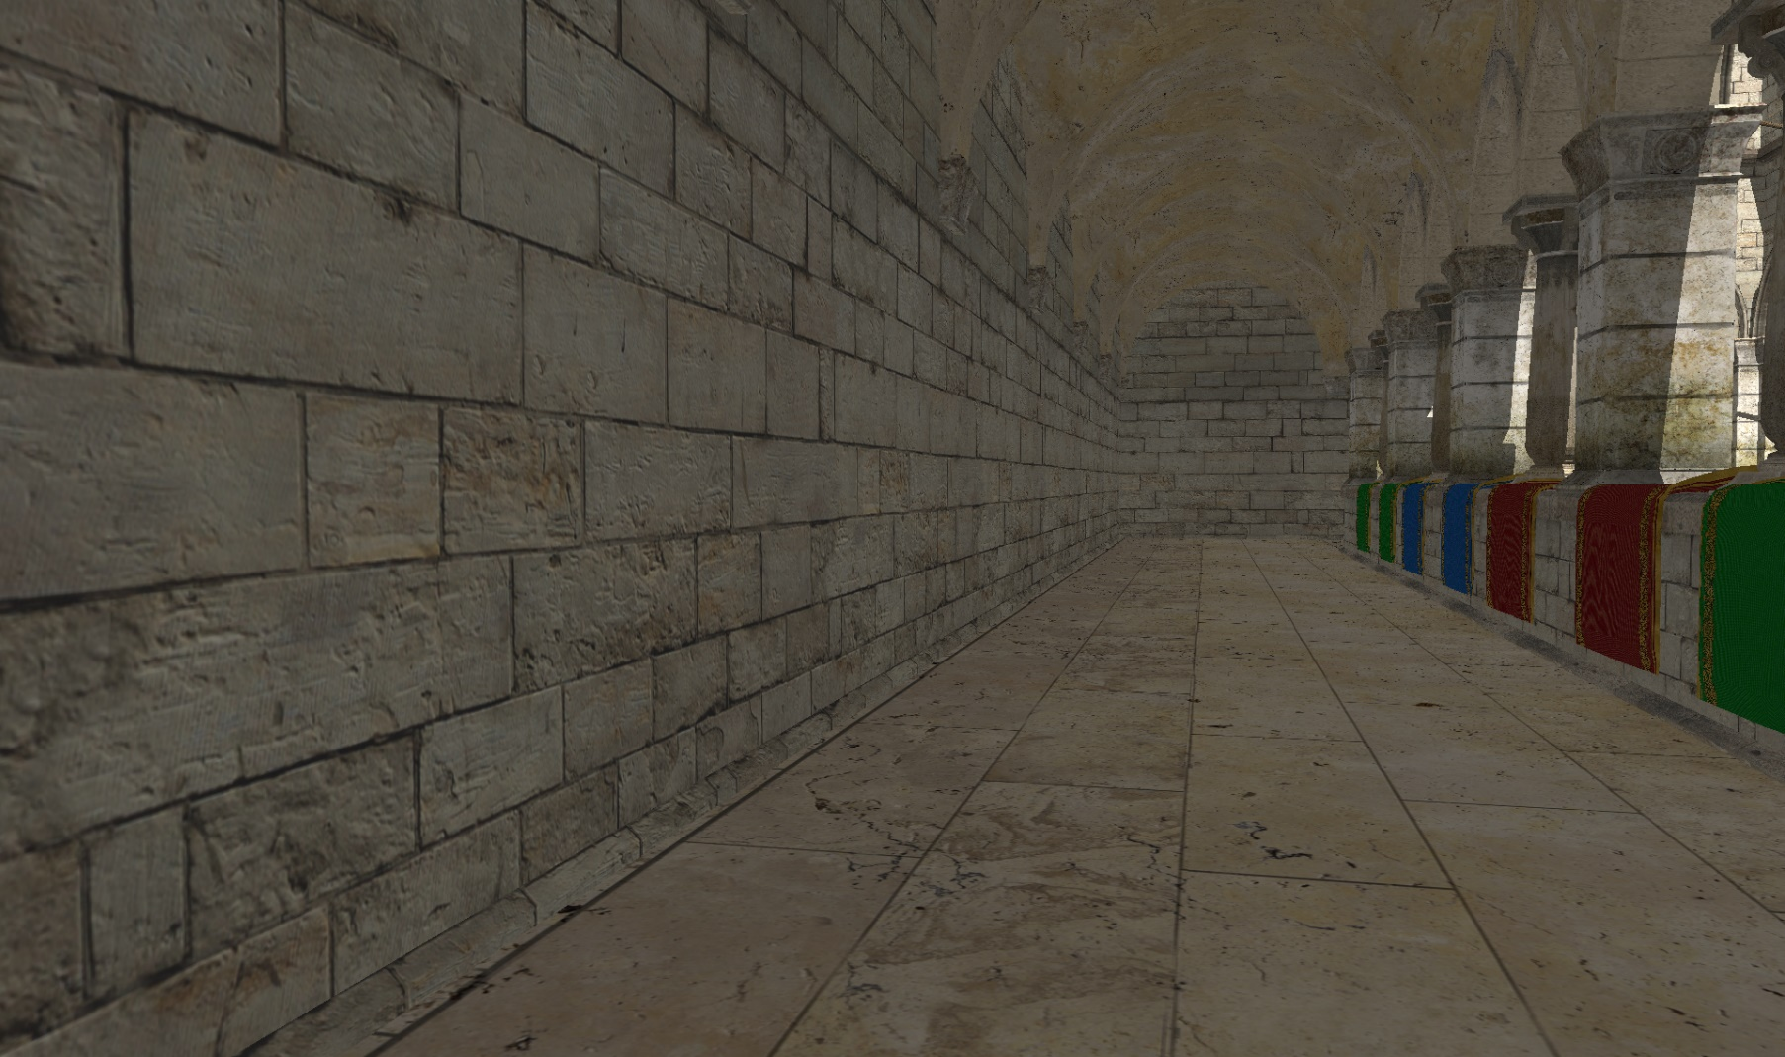
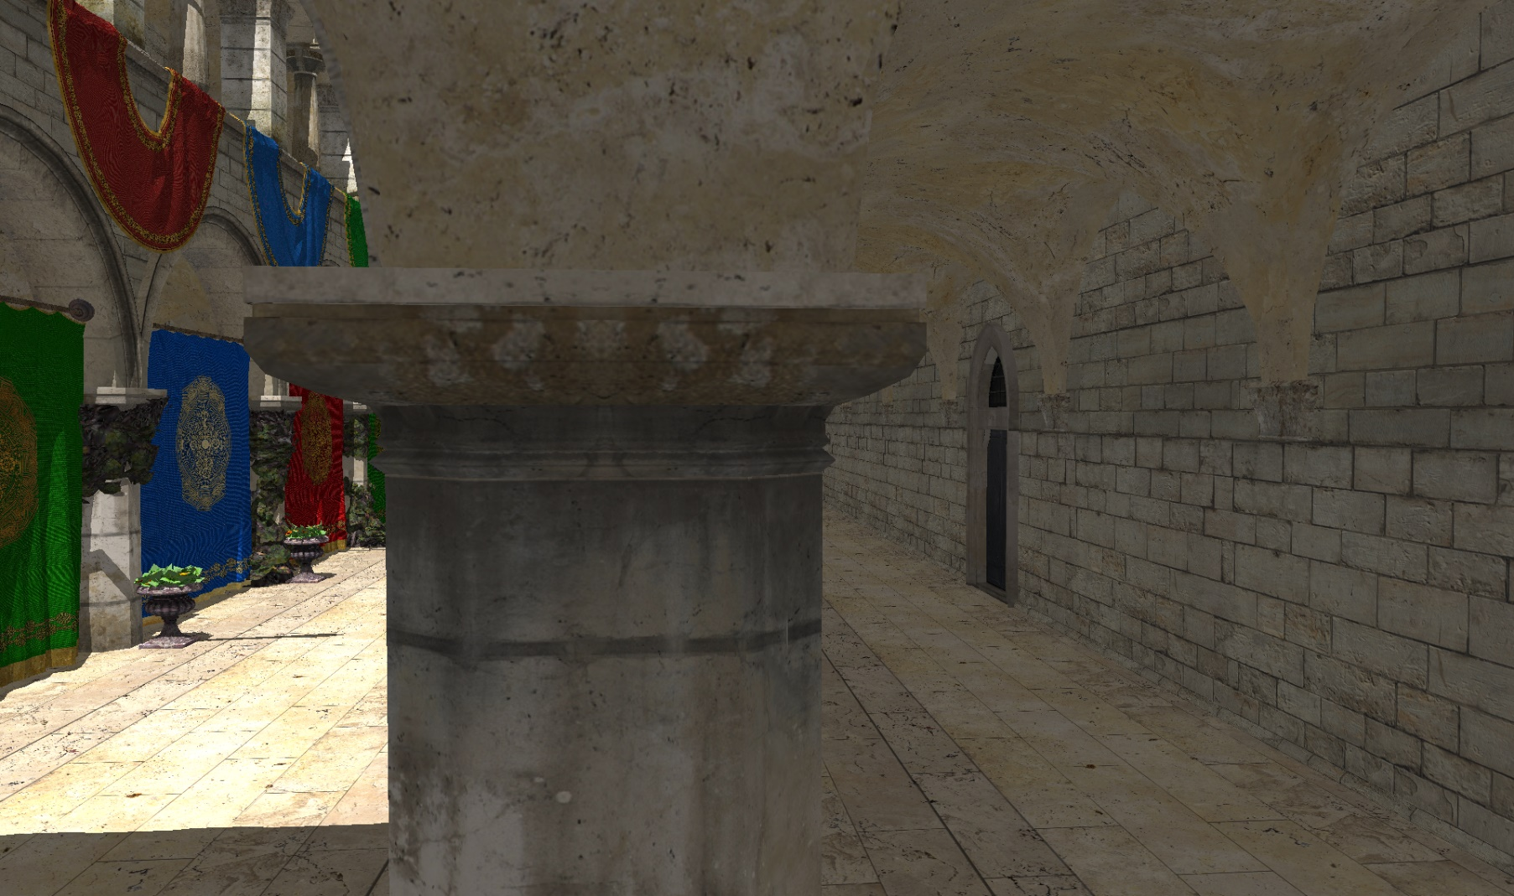
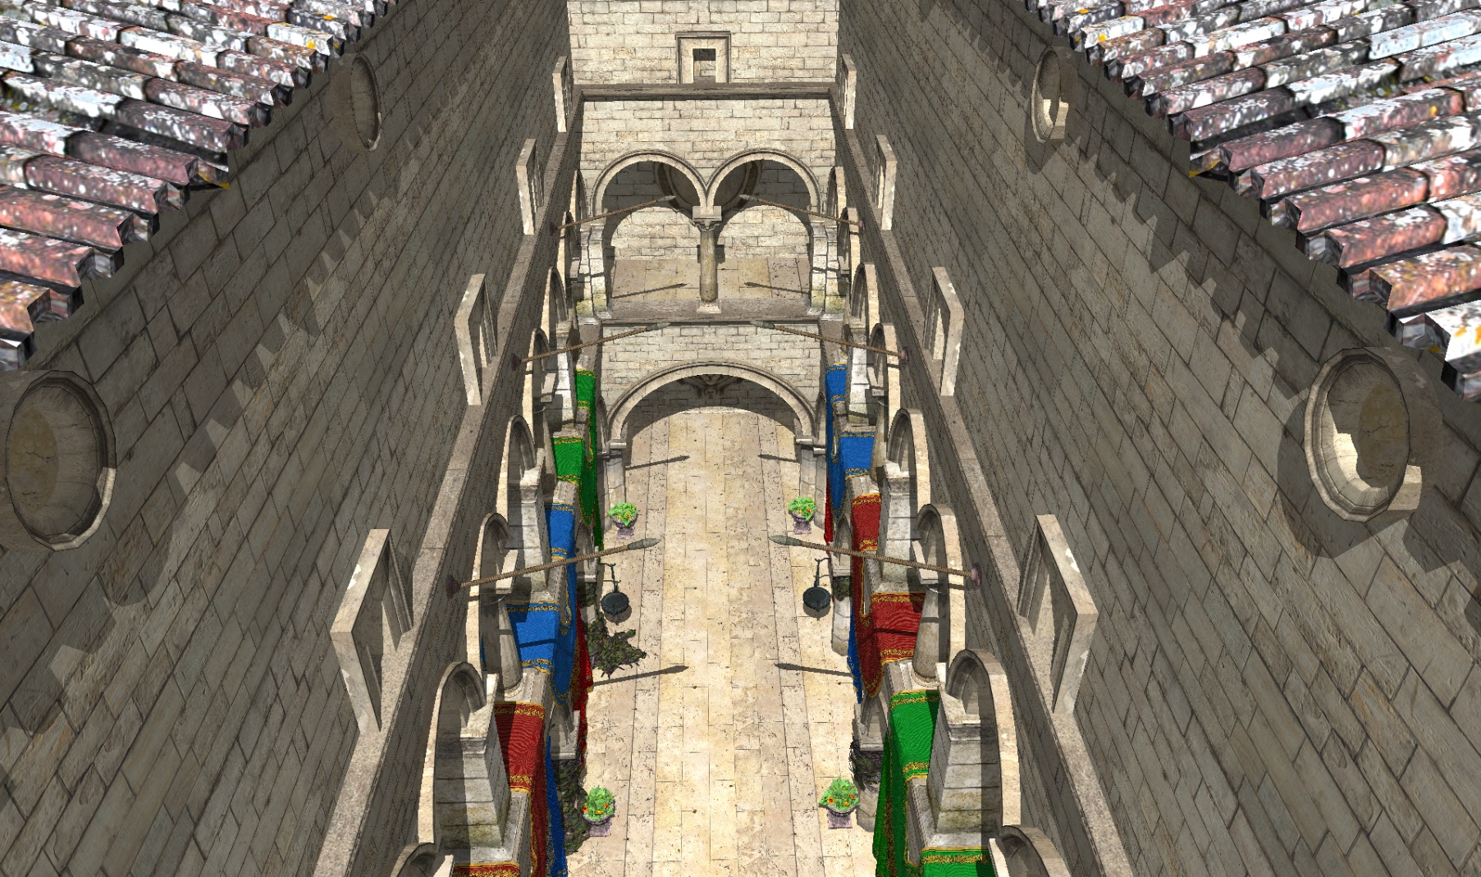
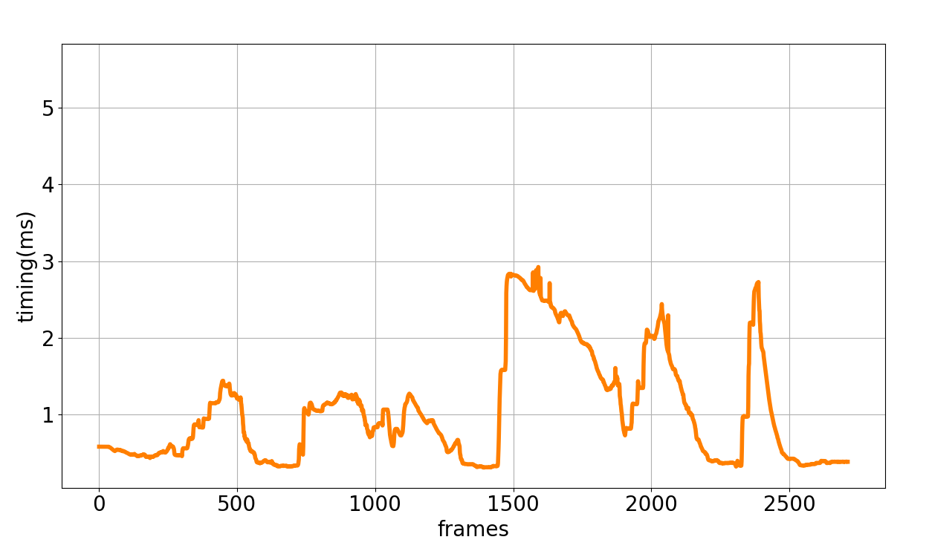
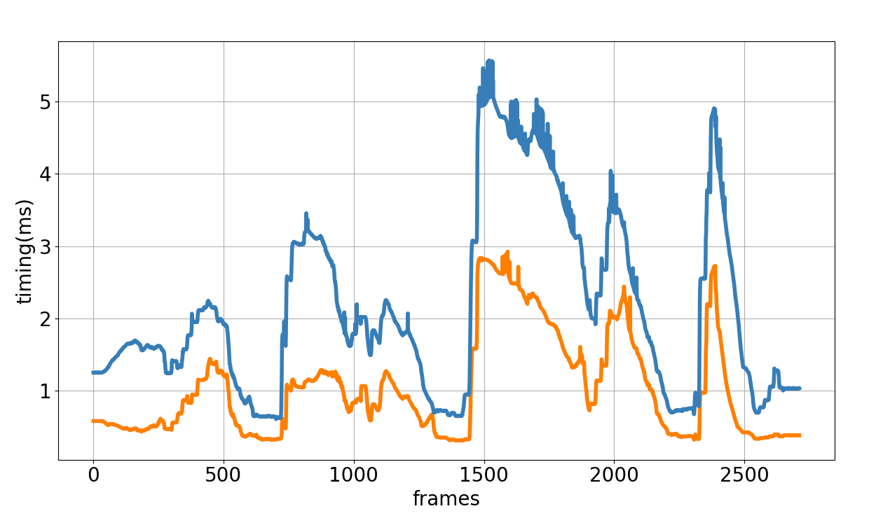
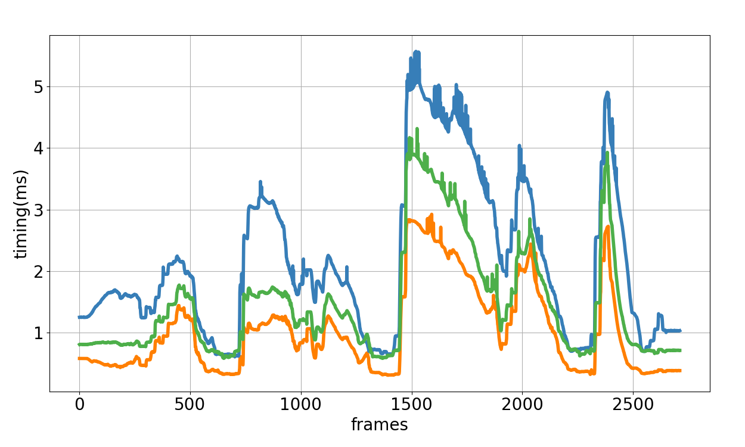
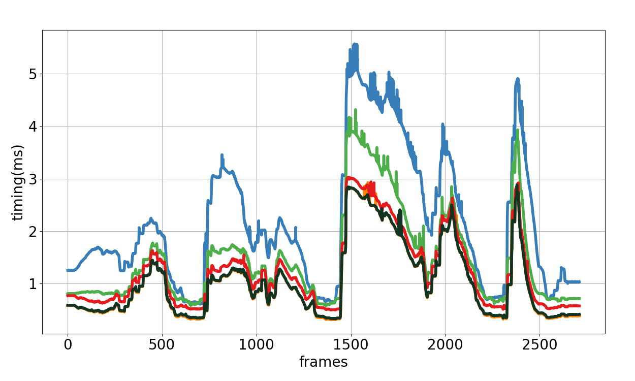
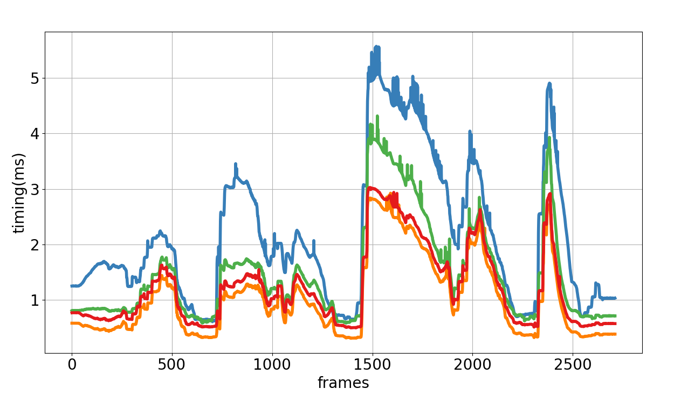
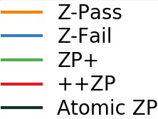
Results

Slide 33
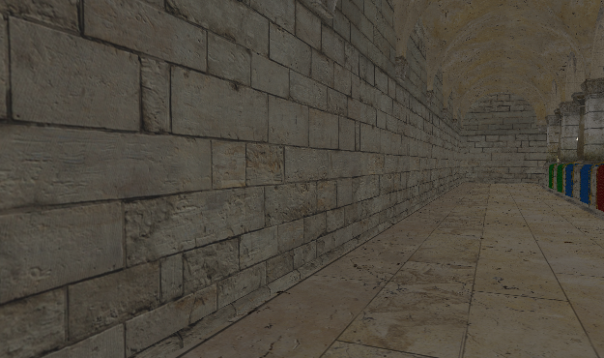
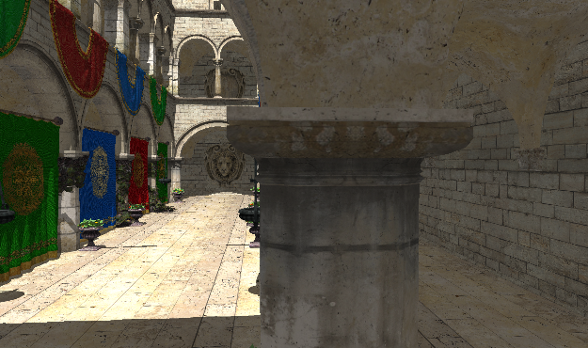
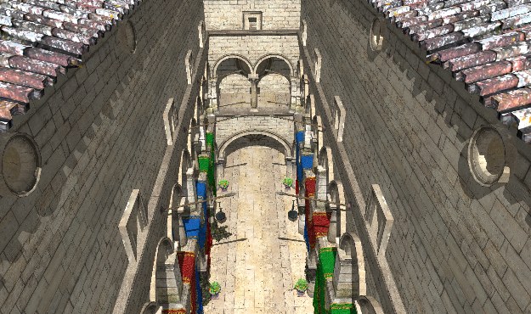
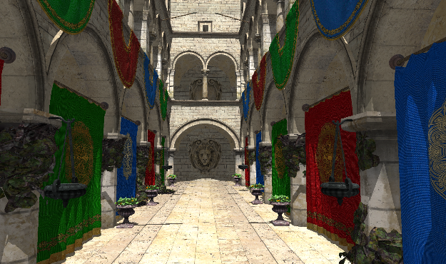
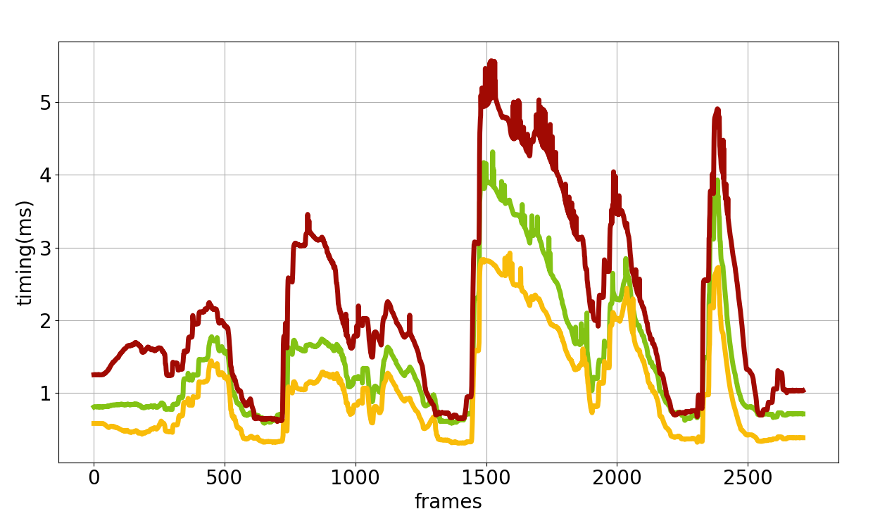
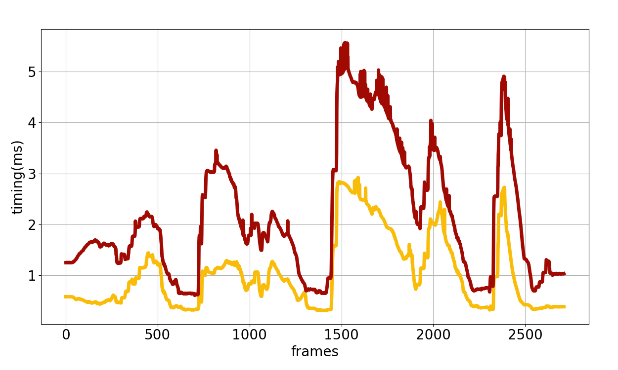
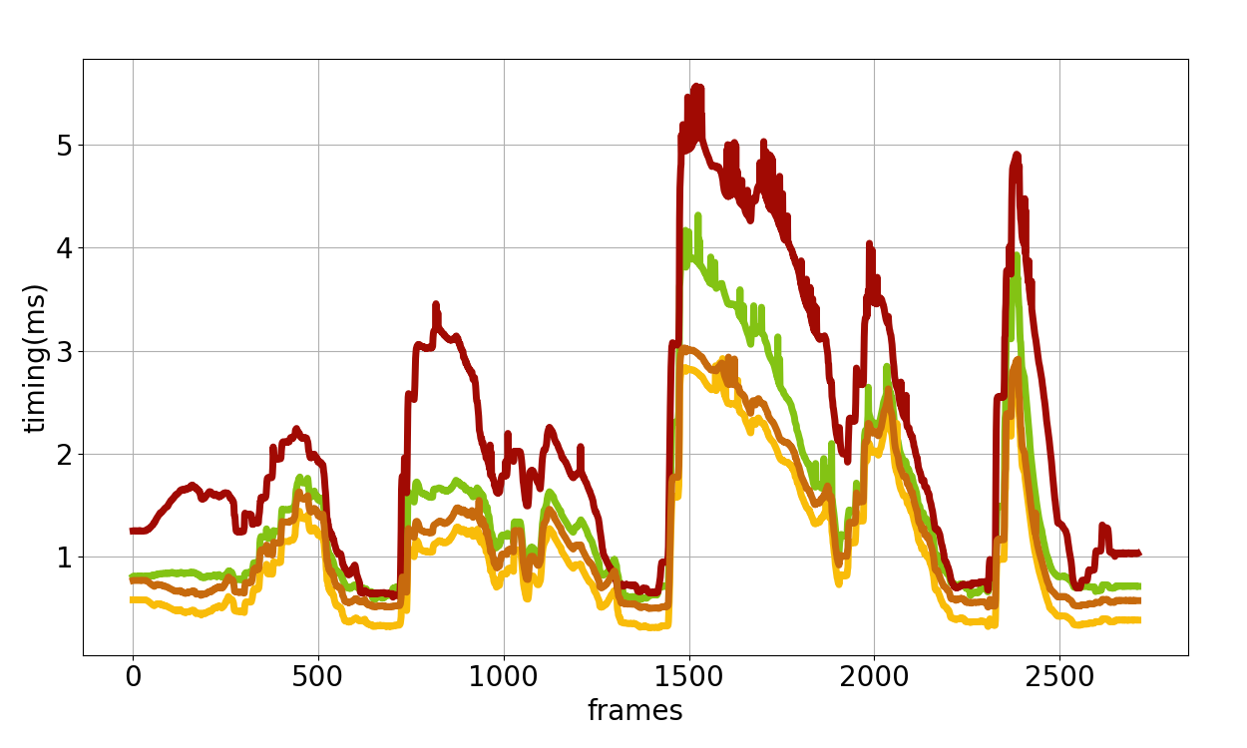
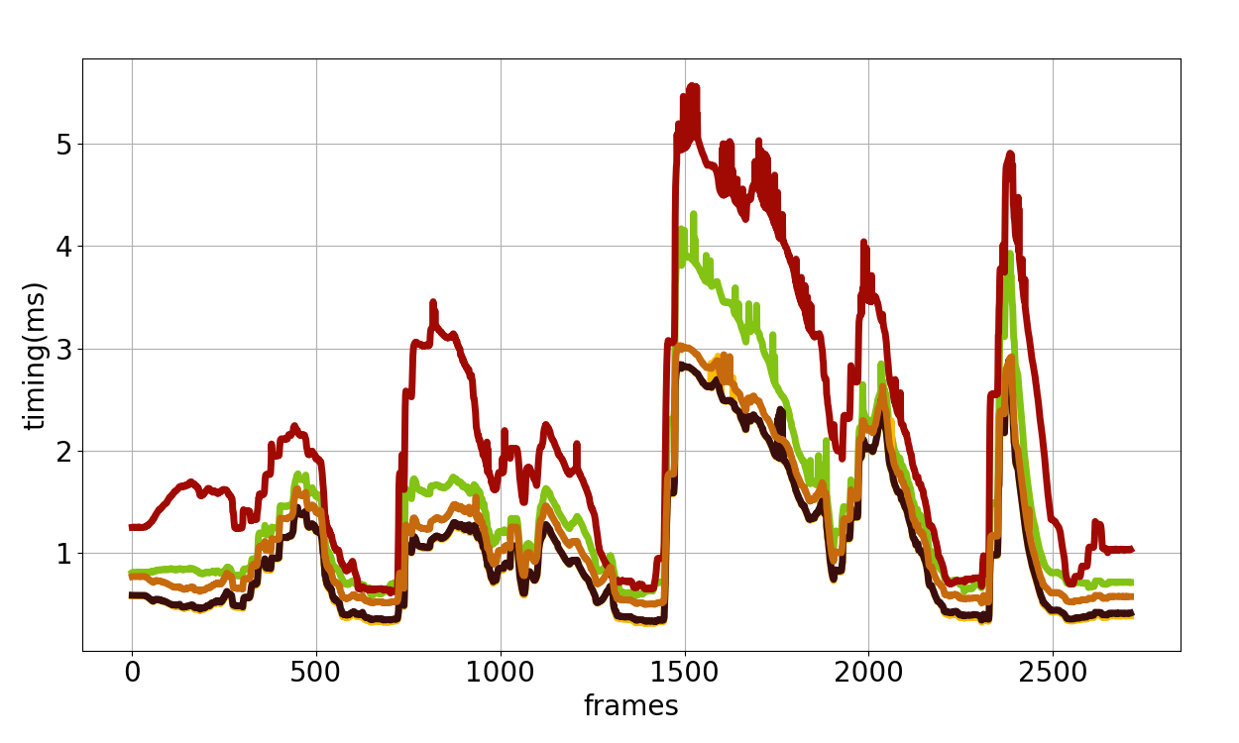
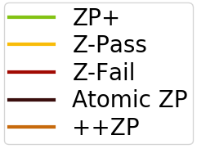
Results

Slide 34
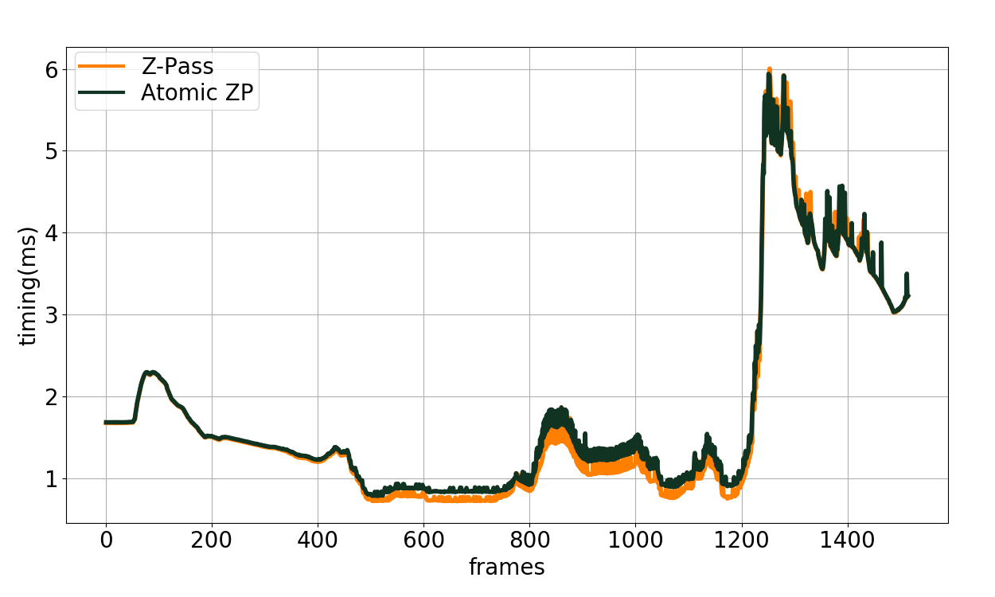
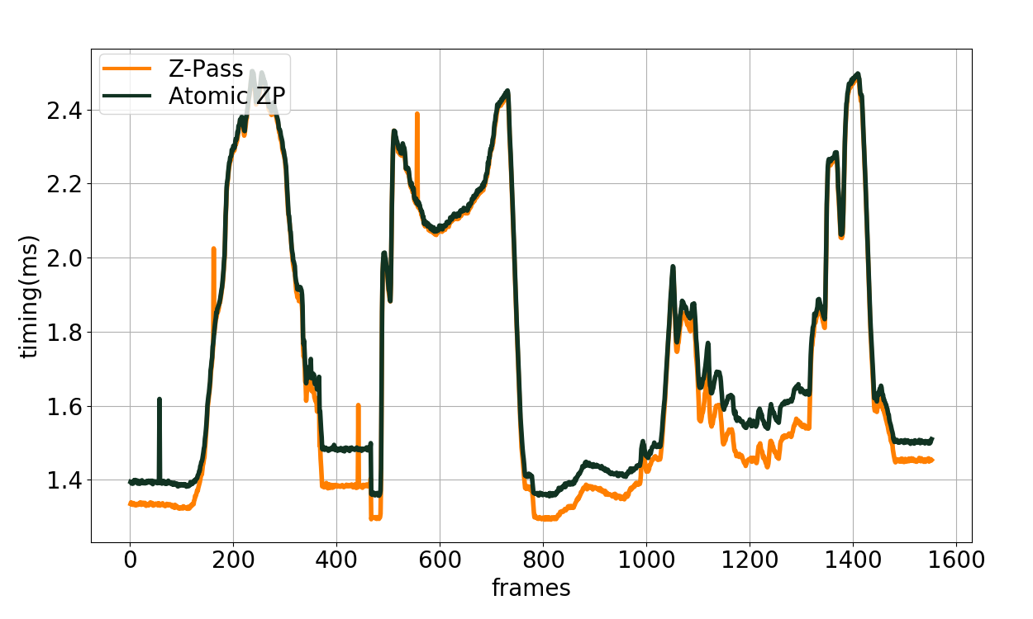
Results
Citadel
Buddha

Slide 35
Results

Slide 36
Conclusion
Easy to implement, artifact free
Avoids additional Render Pass (ZP+ & ++ZP)
Avoids Rendering Hidden Geometry and Caps (Z-Fail)
Performs on par with Z-Pass
1 ray cast per light facing triangle overhead

Slide 37
A Practical and Efficient Approach for Correct Z-Pass Stencil Shadow Volume
http://graphics.tudelft.nl
Baran Usta
Leonardo Scandolo
Markus Billeter
Ricardo Marroquim
Elmar Eisemann
b.usta@tudelft.nl
l.scandolo@tudelft.nl
m.billeter@tudelft.n
r.marroquim@tudelft.n
e.eisemann@tudelft.n
Questions?
This work was supported by DyViTo that is funded by the European Union’s Horizon 2020 programme under grant agreement No 765121 and partially funnded by Swiss National Science Foundation Advanced Postdoc Mobility Project 174321.

Slide 38
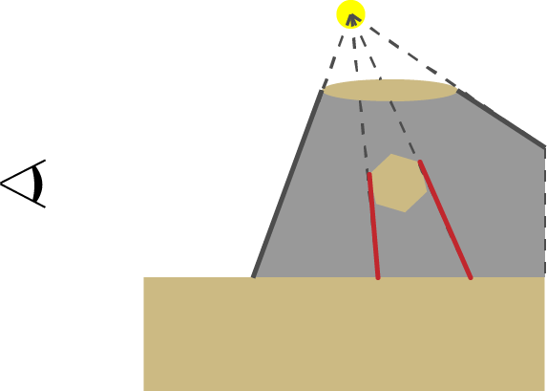
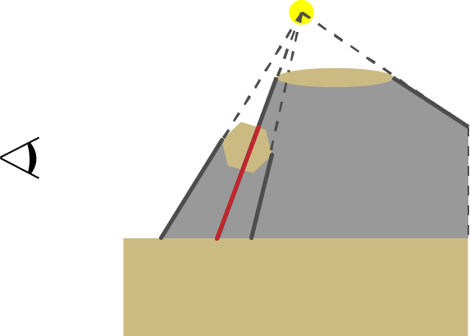
Shadow Volume Generation (Geometry Shader)
Silhouette Edge detection
Modify the index buffer & draw GL_TRIANGLE_ADJACENCY
Edge of 1 FF and 1 BF
Project to Infinity (generates a quad)
Generated face may not be a shadow edge (occluded & clamped)
Occluded
Clamped

Slide 39
ZP+
Edge cases
Near-Plane intersects both projected edge
Near-Plane intersects one projected edge and one infinite edge
Near-Plane intersects both infinite edge

Slide 40
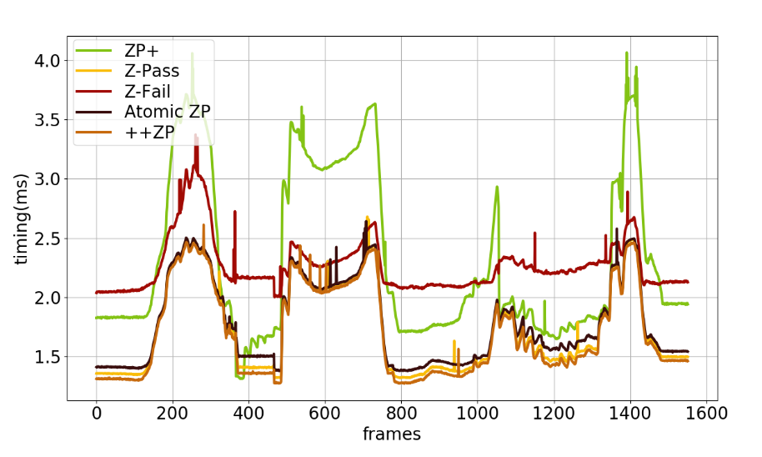
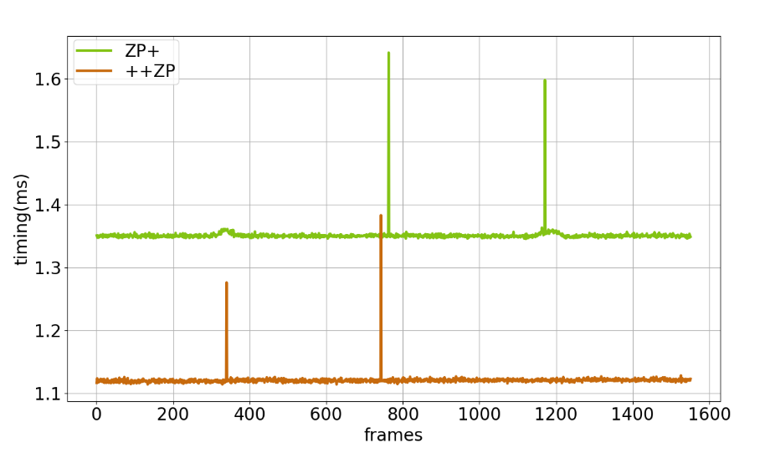
Buddha breakdown
Render Pass
(Stencil Update)
Render Pass
(Stencil Prepass)

